Slide 1
Extending the Enterprise through Web Services
Integrating Existing Applications and Externalizing IT Functionality to Customers, Partners, and Suppliers

Slide 2
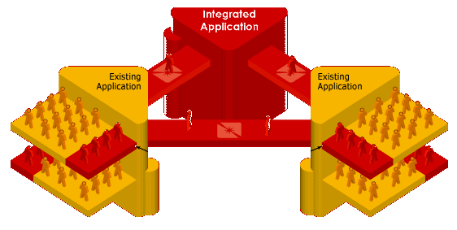
Introduction
Partners
Customers
Suppliers
Added Apps, Users,
And Functionality
Employees
Existing Databases
Most Enterprises have business requirements that span multiple functional areas, requiring application integration.
Almost all IT groups today are looking for ways to extend their existing applications’ functionality to include an integrated set of users like customers, suppliers, and trading partners while continuing to serve their own company’s employees and staff.

Slide 3
Challenges
IT Groups are overworked and understaffed and have few resources to continuously develop custom applications over and over again.
The promises of object-oriented and component-based development have produced better code internally but few real improvements in the way applications are created and deployed (process, usability, performance, etc.)
All IT managers want to stop throwing away code and use their existing systems, databases, and software and still be able to extending the enterprise to new users and revenue sources.

Slide 4


What’s the Solution?
Unfortunately, there is no easy solution.
Fortunately, there are viable options that can help keep existing systems that meet new requirements and support external users at the same time (web portals are a good example).
Enterprise Application Integration (EAI) is a term that is used these days to describe the domain of application functionality sharing and extension of functionality to new users. Web Services is a type of EAI enabler.

Slide 5
What is EAI?
Four major types
  Copy of functionality between applications
  Integration of data but copy of functionality
  Integration of data, functionality and business logic
  Integration of user interface, functionality, data, and business logic

Slide 6
Common EAI
Feature X
Feature X
Feature Y
Feature Y
Feature Z
Presentation
Presentation
Functionality
Functionality
Data
DB
Data
Application A
Application B
copy features and enhance (everything is separate)
Feature X
Feature X
Feature Z
Feature Y
Feature Z
Presentation
Presentation
Functionality
Functionality
Data
Data
Application A
Application B
integrate existing data, but copy features and enhance

Slide 7
Sophisticated EAI
Feature X
Feature X
Feature Y
Feature Y
Feature Z
CORBA
SOAP, RMI
Presentation
Presentation
Functionality
Functionality
Data
DB
Data
Application A
Application B
create API between applications, integrate data, create new data
Feature X
Feature X
Feature Z
Feature Y
Feature Z
Presentation
Presentation
Functionality
Functionality
Data
Data
Application A
Services
Application B
create common services and have all applications use them

Slide 8
What are Web Services?
Simply put, web services are nothing more than a common API (application programming interface).
Consider what ODBC/JDBC and SQL (structured query language) did for databases. They made it possible for just about any software--reporting tools, spreadsheets, even word processors--to extract query results from any database. Any vendor. Any software. Any database.
In the same way that xDBC and SQL provided a standard way for any software to access a discrete package of data (the database), Web services provide a standard way to discreetly package anything (a database, a specific query, some business logic) and make it accessible to anything else (another database, a WAP-enabled phone, or better yet, an external partner's business logic).

Slide 9
Web Services Protocols
Before Web Services, integrating dissimilar systems (internal or external) generally required proprietary interfaces that were difficult to develop and prone to incompatibilities every time one of the integrated systems changed.
Web services are the standard protocols that make application integration possible without requiring you to re-invent the wheel for each new integration project.
Those protocols are XML, SOAP, WSDL, and UDDI. XML and SOAP are probably the two most important ones.
  The idea behind SOAP (Simple Object Access Protocol) is that you have a standard way of accessing objects on any systems that support the protocol.
  XML is simply a standard way of structuring the text that gets passed between these objects. In the same way that Internet browsers understand HTML,
  Think of the logic in the SOAP-based object as a remotely located procedure that needs to be "called" from across the Internet or a local area network. Whatever "calls" that object, be it a WAP-phone or a partner's system, packages its request in XML.

Slide 10
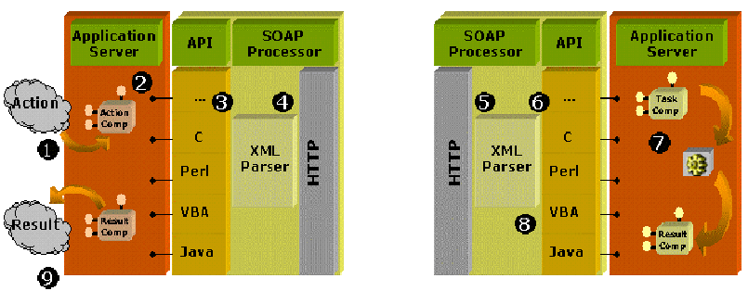
XML and SOAP Overview
SOAP
Request
SOAP
Response

Slide 11
Web Services and Sparx
Shared component repository
Sophisticated, reusable presentation components for thin-client computing
Business rules library
Data access layer (reduce SQL)
J2EE, .NET
XML, SOAP, UDDI, WSDL
Mainframe
Client/Server
Midrange
EAI Server
HTTP
Web/App Server
External Systems
End User

Slide 12
Conclusion
Technology managers today should be cataloging all their current software and looking for ways to turn their software into services.
Software costs significant resources to develop and deploy, but using web services existing software can be modified to provide external services that will enhance revenues.

